Slide 1
Transverse Motion 2
Eric Prebys, FNAL

Slide 2
Some Formalism
Let’s look at the Hill’ equation again…
We can write the general solution as a linear combination of a “sine-like” and “cosine-like” term where
When we plug this into the original equation, we see that
Since a and b are arbitrary, each function must independently satisfy the equation. We further see that when we look at our initial conditions
So our transfer matrix becomes

Slide 3
Calculating the Lattice functions
If we know the transfer matrix or one period, we can explicitly calculate the lattice functions at the ends
If we know the lattice functions at one point, we can use the transfer matrix to transfer them to another point by considering the following two equivalent things
Going around the ring, starting and ending at point a, then proceeding to point b
Going from point a to point b, then going all the way around the ring
Recall:

Slide 4
Calculating the Lattice functions (cont’d)
Using
We can now evolve the J matrix at any point as
Multiplying this mess out and gathering terms, we get

Slide 5
Examples
Drift of length L:
Thin focusing (defocusing) lens:

Slide 6
Physical Implications
The general expressions for motion are
We form the combination
If you don’t get out much, you recognize this as the general equation for an ellipse
Area = πA²
Particle will trace out the ellipse on subsequent revolutions

Slide 7
Interpretation (cont’d)
As particles go through the lattice, the Twiss parameters will vary periodically:
β = max α = 0
➔maximum
β = decreasing α >0
➔focusing
β = min α = 0
➔minimum
β = increasing α < 0
➔defocusing
Motion at each point bounded by

Slide 8
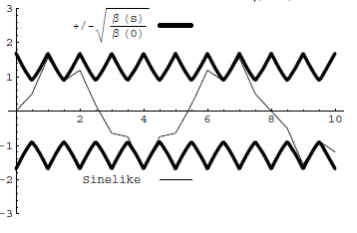
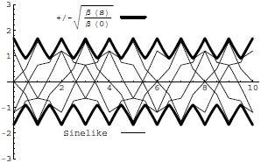
Conceptual understanding of β
It’s important to remember that the betatron function represents a bounding envelope to the beam motion, not the beam motion itself
Normalized particle trajectory
Trajectories over multiple turns
β(s) is also effectively the local wave number which determines the rate of phase advance
Closely spaced strong quads ➔ small β ➔ small aperture, lots of wiggles
Sparsely spaced weak quads ➔ large β ➔ large aperture, few wiggles

Slide 9
Betatron tune
Particle trajectory
As particles go around a ring, they will undergo a number of betatrons oscillations ν (sometimes Q) given by
This is referred to as the “tune”
Ideal orbit
We can generally think of the tune in two parts:
6.7
Integer : magnet/aperture optimization
Fraction: Beam Stability

Slide 10
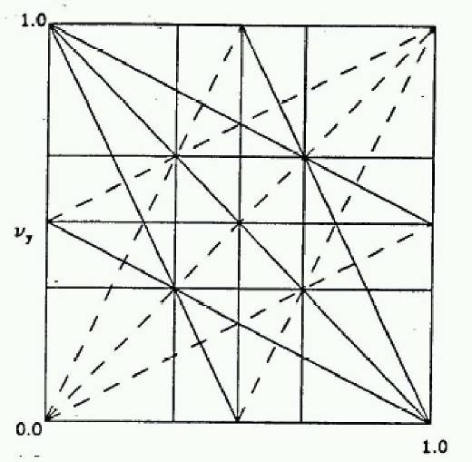
Tune, stability, and the tune plane
(We’ll talk about this in much more detail soon, but in general…)
If the tune is an integer, or low order rational number, then the effect of any imperfection or perturbation will tend be reinforced on subsequent orbits.
When we add the effects of coupling between the planes, we find this is also true for combinations of the tunes from both planes, so in general, we want to avoid
Many instabilities occur when something perturbs the tune of the beam, or part of the beam, until it falls onto a resonance, thus you will often hear effects characterized by the “tune shift” they produce.
“small” integers
➔Avoid lines in the “tune plane”
fract. part of Y tune
fract. part of X tune

Slide 11
Emittance
If each particle is described by an ellipse with a particular amplitude, then an ensemble of particles will always remain within a bounding ellipse of a particular area:
Area = ε
Either leave the π out, or include it explicitly as a “unit”. Thus
microns (CERN) and
π-mm-mr (FNAL)
Are actually the same units (just remember you’ll never have to explicity use π in the calculation)

Slide 12
Definitions of Emittance and Admittance
Because distributions normally have long tails, we have to adopt a convention for defining the emittance. The two most common are
Gaussian (electron machines, CERN):
95% Emmittance (FNAL):
It is also useful to talk about the “Admittance”: the area of the largest amplitude ellipese which can propagate through a beam line
Limiting half-aperture

Slide 13
Adiabatic Damping
Printed copy has lots of typos!
In our discussions up to now, we assume that all fields scale with momentum, so our lattice remains the same, but what happens to the ensemble of particles? Consider what happens to the slope of a particle as the forward momentum.
If we evaluate the emittance at a point where α=0, we have
Normalized emittance

Slide 14
Mismatch and Emittance Dilution
In our previous discussion, we implicitly assumed that the distribution of particles in phase space followed the ellipse defined by the lattice function
Once injected, these particles will follow the path defined by the lattice ellipse, effectively increasing the emittance
Lattice ellipse
…but there’s no guarantee
What happens if this it’s not?
Area = ε
Injected particle distribution
Effective (increased) emittance

Slide 15
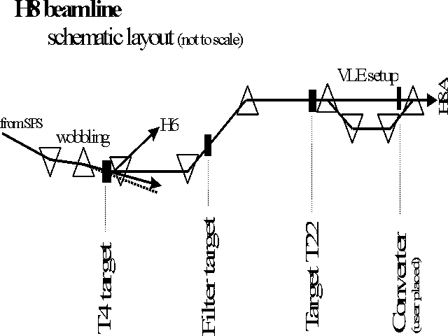
Beam Lines
In our definition and derivation of the lattice function, a closed path through a periodic system. This definition doesn’t exist for a beam line, but once we know the lattice functions at one point, we know how to propagate the lattice function down the beam line.

Slide 16
Establishing Initial Conditions
When extracting beam from a ring, the initial optics of the beam line are set by the optics at the point of extraction.
For particles from a source, the initial lattice functions can be defined by the distribution of the particles out of the source

